Slide 1
TCP Group Chat
Josh
Gilbert
Jesse

Slide 2
Overview
We created a simple chat room for relaying messages between users wirelessly
A graphical user interface was created for ease of use interacting with the application.
Utilized sockets

Slide 3
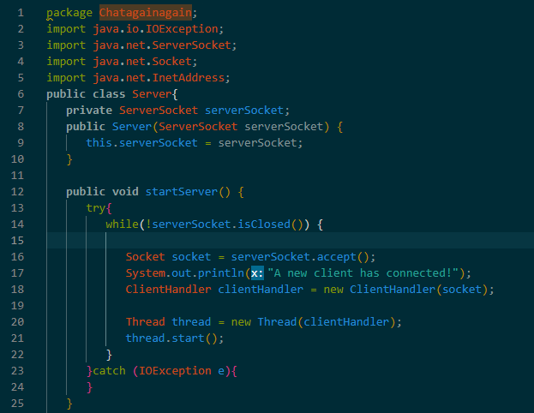
Server.java
Function startServer()
When a new socket is accepted/ a new user joins it will print out a message in the terminal
A new client handler will be created using the socket
A new thread will be created

Slide 4
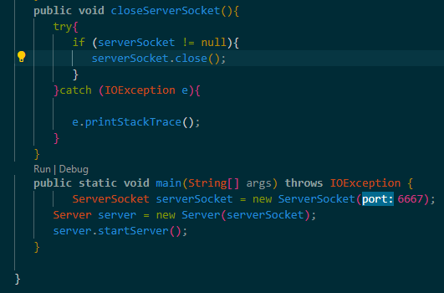
Server.java
closeServerSocket()
Function to close the server
If all sockets/users disconnect then the server will close
Main()
Creates a new socket, creates and starts server

Slide 5
ClientHandler.java
Created using a socket in main() of Server.Java
Keeps track of client info
Provides methods to inform users of the state of the chat room (enters/leaves)
Manages server input, and output streams

Slide 6
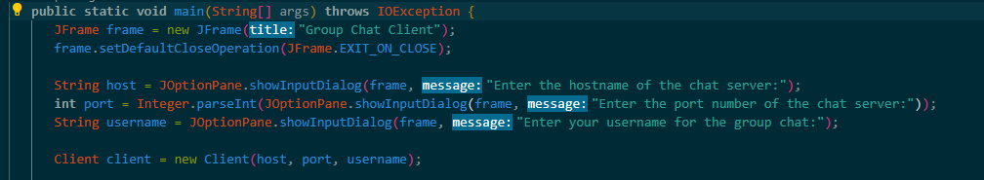
Client.java: New User
When running the client, 3 dialog boxes will pop up asking for the hostname, port number, and for the user to create a username
This info gets stored in a new client object as the user joins the chat room

Slide 7
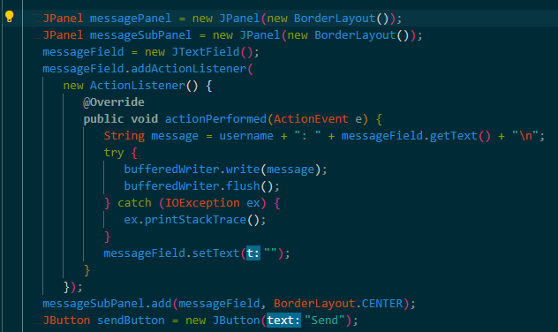
Client.java: Group chat box and message field
Utilized Jpanel from javax.swing for the Panel, sub panel and field for the chat box
Attached an ActionListener to the message field box so that when the send button is hit whatever is in the message field is sent to the chat
The field is then erased

Slide 8
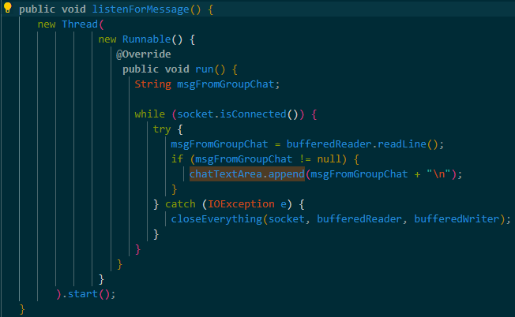
Client.Java: ListenForMessage()
Responsible for updating the group chat text area
Since it is constantly being updated a runnable interface is implemented in a thread so that it can actively continue to receive and print messages to the group chat for all users to see

Slide 9
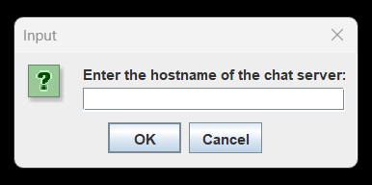
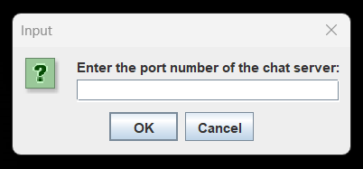
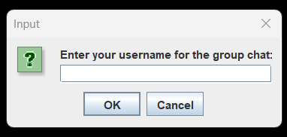
Screenshots
Once you run the client file 3 dialog boxes will pop up.
One to enter the IP address of the chat server
One for the port number
One to create your username.

Slide 10
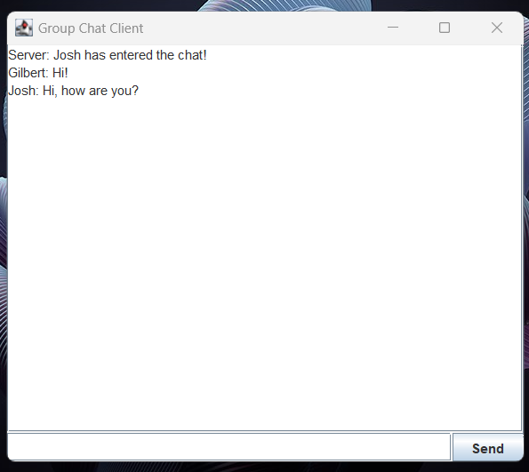
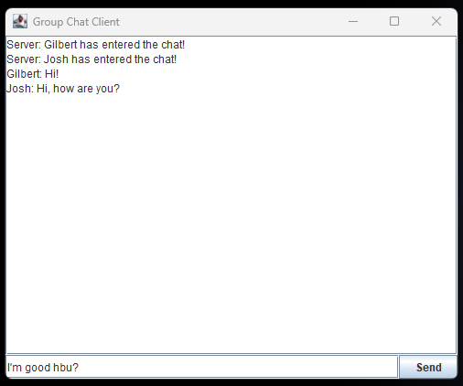
Screenshots
Josh Gilbert
ChatTextArea
Message field
Send button

